Slide 1
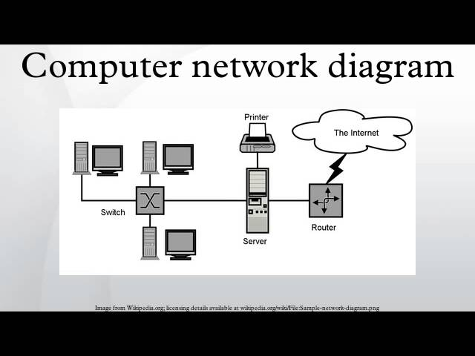
Concept of System Design
Presented by:sachin simkhada
Class 12 computer chapter 6
Date :2081/08/19
Prime international collage khushibu kathmandu

Slide 2
What is System Design?
-Definition
System Design is the process of planning and creating the architecture of a system.
It involves defining components, their interactions, and the flow of data.
The goal is to meet functional (what the system does) and non-functional (how it performs) requirements.
Focuses on building scalable, efficient, and maintainable systems.
Includes both high-level design (overall architecture) and low-level design (detailed components).
Ensures the system is reliable, secure, and can handle growth or increased usage.

Slide 3
Key Concepts in System Design
Scalability:
Ability of a system to handle increasing amounts of work or users.
Ensures the system can grow and adapt over time (e.g., handling more traffic).
Availability:
The system’s ability to remain operational and accessible with minimal downtime.
Often measured as uptime percentage (e.g., 99.9% availability).
Maintainability:
The ease with which a system can be updated, modified, or fixed.
Involves modularity and clear documentation for easier upgrades and repairs.

Slide 4
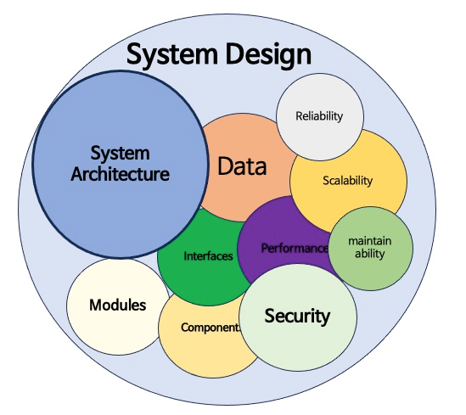
Key Concepts in System Design
Performance:
How well a system performs under load, such as processing speed and response time.
Critical for user experience, especially for high-traffic applications.
Security:
Protecting the system from unauthorized access, data breaches, and attacks.
Involves encryption, authentication, and secure data handling.

Slide 5
Steps in System Design
Requirements Gathering:
Understand the problem the system needs to solve and what features it should have.
High-Level Design:
Define the system’s overall architecture and major components.
Identify how components will interact and the technology stack to be used (e.g., client-server model, cloud infrastructure).
Low-Level Design:
Break down each component into smaller modules and define their internal workings.
Design data structures, algorithms, database schemas, and APIs for individual components.
Prototyping & Testing:
Build prototypes or mock-ups to test ideas and concepts.
Conduct initial tests to check functionality, performance, and usability.

Slide 6
Steps in System Design
Implementation & Deployment:
Develop the system based on the design and deploy it for use.
Ensure the system is fully functional and meets user requirement.
Maintenance & Upgrades:
Continuously monitor the system’s performance, fix bugs, and update features.
Scale the system as needed and adapt to changing requirements or technologies.
[Requirements Gathering] → [High-Level Design] → [Low-Level Design]
↓ ↓ ↓
[Prototyping & Testing] → [Implementation & Deployment] → [Maintenance & Upgrades]

Slide 7
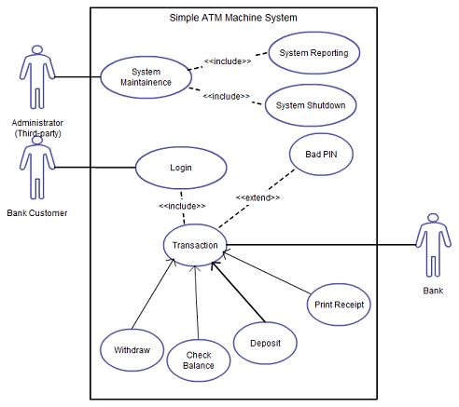
Conclusion & Example
System Design is critical for building scalable, reliable, and maintainable systems.
For example : The working system of ATM machine.
Here is the image shows working system of ATM machine.

Slide 8

The END
Thank you

